Slide 1
Social Data Science Data and Big data
David Dreyer Lassen
UCPH ECON
August 11, 2017

Slide 2
In God we trust, all others must bring data
W. Edwards Dewing

Slide 3
Today: 1. Empirical design 2. data generating process 3. modes of collection standard vs big data; examples 4. strategic data provision

Slide 4
roadmap
Different data for different questions
Theory and empirics, forecasting and hypothesis testing
Effects of causes vs. Causes of effects
Data generating process
Modes of data collection – pros and cons
Strategic data management and data production

Slide 5
Different data for different questions or Different questions for different data
Sometimes possible to separate data collection process from underlying data generating process – and sometimes not
Fundamental difference between what people do and what they say they do
‘cheap talk’ / ‘put your money where your mouth is’ / honest/costly signaling

Slide 6
roadmap
Different data for different questions
Theory and empirics, forecasting and hypothesis testing
Effects of causes vs. Causes of effects
Data generating process
Modes of data collection – pros and cons
Strategic data management and data production

Slide 7
What is your question, again?
Research question from theory
Ideal empirical design
Feasible empirical design / collection
Results
Adjustment of theory/question/design
New results
…
What data do we have
What question can they answer
Research question
Results

Slide 8
All models are wrong – but some are useful
George Box
Two key goals
Forecasting: individual behavior, policy consequences, voting, Champions League, grades … Data science / machine learning (but also macroeconomics)
Hypothesis testing, derived from theory ´Traditional’ social science

Slide 9
Forecasting
Example: Bank wants to forecast non-payment on loans (P_d: probability of default)
Couldn’t care less about theory
Rough ”Data Science”: try to predict from all available data
Suppose we find that birth weight predicts default
Bank is happy, better fit (defer ethics etc)
Policy: does investing in pre-natal care reduce defaults?
In practice: set of predictors typically taken from (some) theory, even if casual
Complications: if customers know that P_d depends on birth weight, would/should they disclose it? What if loans only to disclosers? Would they tell the truth?

Slide 10
2. Hypothesis testing
Theory (rational choice, sociology, biology, common sense, …) posits effect of X on Y
Selection/type theory: People who are impatient cannot defer immediate pleasures -> smoke and drink while pregnant -> give birth sooner. If impatient parents -> impatient children (whether by nature or nurture), we have an explanation.
Biological theory: low birth weight affects brain development and neurological wiring for patience.
If (A), little role for policy; also, both can be true at same time
How to distinguish: exogenous shock to birthweight, but ethically tricky ...

Slide 11
Goodhart’s law
Most popular: “When a measure becomes a target, it ceases to be a good measure.”
What he wrote: “Any observed statistical regularity will tend to collapse once pressure is placed upon it for control purposes.”

Slide 12
Targets and Measures
You cannot be told how your bank constructs your P_d. Why?
Goodhart’s law: people will attempt to outmaneuver measure
(thought)example: spending on shoes good indicator of account overdraft -> shoe lovers will have others buy for them, ceases to be a good measure

Slide 13
Case of Google Flu
Google Flu: web searches for Flu symptoms predicted actual flu cases
By-product of Google’s main service
But from 2010, not so well: overestimated actual flu cases, partly as result of autosuggest feature, partly because model was overfitted (we’ll return to that)
Best predictor: number of cases past week

Slide 14
roadmap
Different data for different questions
Theory and empirics, forecasting and hypothesis testing
Effects of causes vs. Causes of effects
Data generating process
Modes of data collection – pros and cons
Strategic data management and data production

Slide 15
Effects of causes vs. Causes of effects
Different questions
Effects of causes: intervention, what is effect of policy X on outcome Y
Causes of effects: Why does Z occur?

Slide 16
Effects of causes (forward causal questions)
Narrow questions, sometimes (but not always) policy interventions
Effect of tax change on behavior
Effect of regulation on risk taking
Effect of schooling on earnings
Effect of smoking on lung cancer propensity
Effect of public health on schooling in Africa
…
Often, but not always, amenable to treatments/ randomization/experimentation

Slide 17
Causes of effects (reverse causal inference)
Much harder, but often more interesting
Why do some people smoke?
What are the causes of democratization?
Why do some people pursue a PhD why others drop out after primary school?
Why did Greece (almost) go bankrupt?
Tensions with ”effects of causes” – search for causes sometimes derided as ‘party chatter’

Slide 18
roadmap
Different data for different questions
Theory and empirics, forecasting and hypothesis testing
Effects of causes vs. Causes of effects
Data generating process
Modes of data collection – pros and cons
Strategic data management and data production

Slide 19
Data generating process
What is the data generating process?
Observational: endogenous decisions, researcher passive collector of data
Randomization: treatment-control
(Some) exogeneity: policy interventions, sometimes with comparisons, researchers sometimes involved
Important: more data does not give better result/more precision if estimator is biased

Slide 20
Randomized experiments
Distinguish
Lab experiments: traditionally computer-based in econ, but also eye tracking/brain images (fMRI)/physiological
Survey experiments: assign survey respondents to different frames/treatments/primings, e.g. have SocDems and Liberals say same thing and look at support
Field experiments: experimental control in the real world, e.g. banks charging different rates to learn about mobility of customers; interventions against teacher absenteeism in India; …)

Slide 21
Randomized experiments
Distinguish
Natural experiments (weather induced: effects of poverty on violence, randomization of names on election ballots, …)
Quasi-experiments (effects of change in policy; effect of tax reform on tax planning; effect of immigrant allocation on crime)
Throughout: exogenous (outside of the individual) change

Slide 22
Randomized experiments
Large, important current debate in (development) economics
CofE: what are effects of penalties on teachers’ absence in Indian village schools – evidence from randomized experiments
Randomly selected teachers get harsh penalty for no-shows -> difference in absenteeism causal effect of penalty
(Broader EofC Q: why is education sector in rural India so inefficient?)

Slide 23
Randomized experiments
Strong on internal validity: from randomization any effect on absenteeism is from harsher penalties; good for testing theory
Weak(er) on external validity – would effect be similar in Africa? Would effect from lab work outside lab? Why, why not?
(compare: medicine works in similar ways across locations)

Slide 24
Randomized experiments
Challenges
Limits to what can be studied by experimentation ( ethics; law; feasibility)
Funding (field experiments expensive, survey exp less so)
Often participation constraint – voluntary participants’ gain >= 0 or no incentive
Subjects leave for various (systematic) reasons
Large-scale randomization can be hard in field experiments

Slide 25
Observational data
Generated without experimental or exogenous intervention
Typically reveals correlations or descriptive patterns that can be interesting in themselves

Slide 26
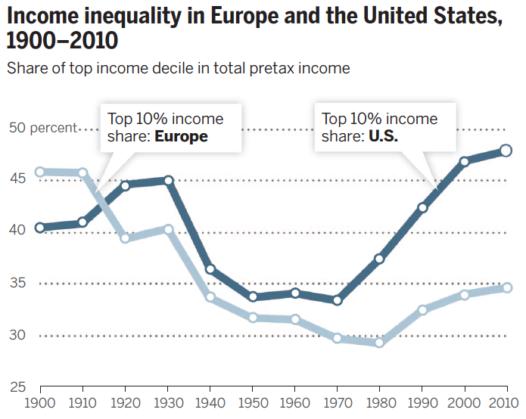
Example: Inequality
Source: Piketty and Saez, Science 2014, tax return data

Slide 27
Observational data
Generated without experimental or exogenous intervention
Typically reveals correlations or descriptive patterns that can be interesting in themselves
Are in themselves silent about causality
Theory may be provide structure to learn about causal mechanism under strong assumptions
May conflate correlation and causality

Slide 28
Observational data
Exple: Does being in private schools affect grades
Classic: Catholic schools and grades in US
Collect attendance and grades -> run regression
But: suppose some parents are more focused on schooling than others
Send kids to private school more
More involved in school + homework
What do higher grades measure?
Effect of private school OR effect of involved parents?

Slide 29
Observational data
What to do?
Assign kids/parents randomly to private schools?
More complicated
Waiting-list experiment design: people who sign up reveal themselves as school interested, compare grades between those in program and on waiting list -> much narrower design
Modeling (US case): use fact that Catholics are much more likely to choose Catholic schools

Slide 30
Big data is often observational
Not always basis for causal claims
But interesting nonetheless: Description
Can (potentially) be combined with natural/quasi-experiments.
Example: very detailed data on transportation/mobility and exogenous weather shocks-> effect of weather on mobility
Payday and consumption

Slide 31
roadmap
Different data for different questions
Theory and empirics, forecasting and hypothesis testing
Effects of causes vs. Causes of effects
Data generating process
Modes of data collection – pros and cons
Strategic data management and data production

Slide 32
Modes of data collection
(Ethnographic / participant observer)
Survey
Interview survey (in person), phone survey, internet survey, …
Administrative data
Used for administrative purposes
Some countries: census, tax return
DK: CPR-registry based
(Primary collection: texts, counting)
“Big data”: in social sciences typically a by-product of digital information

Slide 33
Modes of data collection
Note: survey, admin data, big data can all have randomized / exogenous elements or be purely observational
Often in Lab/field experiments: ask about income, education etc – but may be biased
Sometimes: combine experimental data with admin or big data (but rare)

Slide 34
Ethnographic
Pros
Attempt to understand situations from participants’ perspective
Very detailed observations (e.g. dynamics at a meeting: who speaks when, who listens, who nods off and flirts etc)
Cons
Very difficult to generalize (if even the goal)
Typically very small n, not for stats
Hard to reproduce / replicate

Slide 35
Surveys
Pros
Can be cheap
Elicit info on attitudes, beliefs, expectations
Necessary when no other means exist
Combine with open-ended info
Easily anonymized (firms; China)
Cons
Can be expensive
Non-random samples, sometimes very much so (paid surveys)
Cheap talk
Diverse interpretations (e.g. 1-10 scales, Maasai example)
Very different quality: interview vs. internet
Not full researcher control: Interviewer completions

Slide 36
Administrative data
Denmark, Norway, Sweden
Population-wide
Ex: Know population ‘by pressing Enter’
Most other countries: census (counting people), surveys, rough approximations
In DK, built on Central Person Registry number
System constructed for source taxation in 1960s, now used as ubiquitous identifier
Why do some countries have CPR-like systems and some not?

Slide 37
Administrative data
Pros
Often full population
In DK: third party reported -> no reporting bias, no survey bias
Very detailed, no survey fatigue
Often very precise, since used for admin purposes
Cons
No soft data (attitudes, expectations); can be linked to surveys
Privacy concerns
Restricted to what is collected for admin reasons, both type and frequency (e.g. annual)

Slide 38
Administrative data
Lots of work in Danish econ utilizes register data
Taxation
Education
Health
Financial decisions
Labor market
Combined with
Personality measures
Attitudes/political prefs from surveys
Expectations from surveys
Biological data (neuro-measures, genetics)
Data from experiments

Slide 39
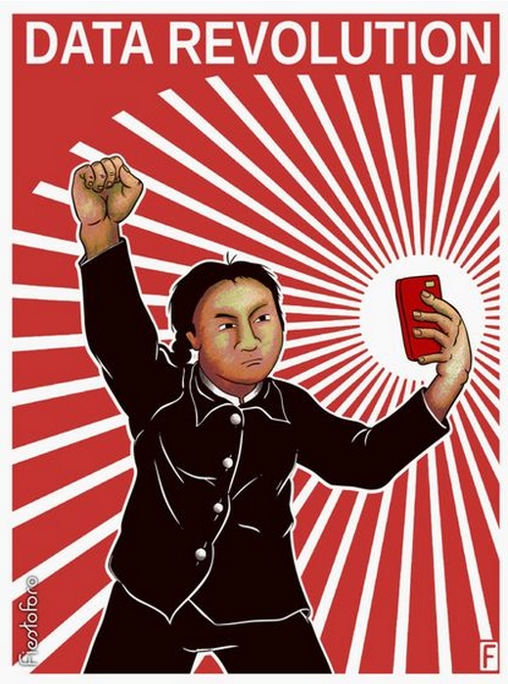
Viva la revolución?
Harnessing the Data Revolution
for Good
Human Development Report Office

Slide 40
Big data

Slide 41
No agreed upon definition what Big Data is
Large N?
High frequency / much detail?
Many different measurements?
Based on what people do (‘honest signals’)
ctr surveys
Not always honest
Different to different people/traditions
To Americans, Danish admin/register data is big data

Slide 42
‘Big data’
Pros
Often based on real decisions (as admin data), but more detail, e.g. auctions
High frequency (e.g. wifi), high granularity -> almost ‘large N ethnographic data’
Sometimes cheap/free
Cons
No established protocol for collection
Sometimes dubious quality, selection issues (both known/unknown)
Start-up costs
Even more privacy concerns
Corporate gatekeepers -> bias in access (Facebook, Google)

Slide 43
Characteristics of ‘big data’
Structured (row/column-style) vs. unstructured (images/sound)
Temporally referenced (date, time, frequency)
Geographically referenced (wifi, bluetooth, Google)
Person identifiable (identify vs. distinguish individuals vs. not distinguish individuals)
Separate medium (e.g. phone) from owner

Slide 44
Example: Social Fabric
Large-scale (N=1000) big data project
Handed out smart phones to DTU freshmen
Collected phone, SMS/text/email (not content), GPS, wifi, bluetooth data
-> Where, when, with whom
-> social networks

Slide 45
Why phone data
Phones as sociometers
Many/most people carry phone with them all the time
Would be IMPOSSIBLE to have people report in detail for every 10 min every day for a year
For this project: tailored software, but realized that many apps collect detailed wifi-data without telling
Concern: take-up of phones

Slide 46
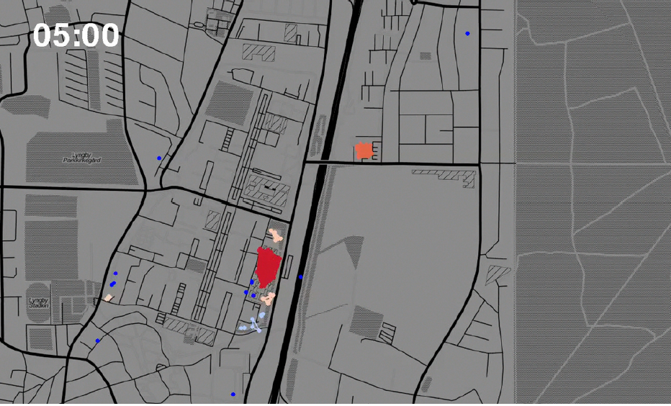
Example: Social Fabric
Phone locations 0500h Monday morning -> can predict where people at given time with 85% accuracy

Slide 47
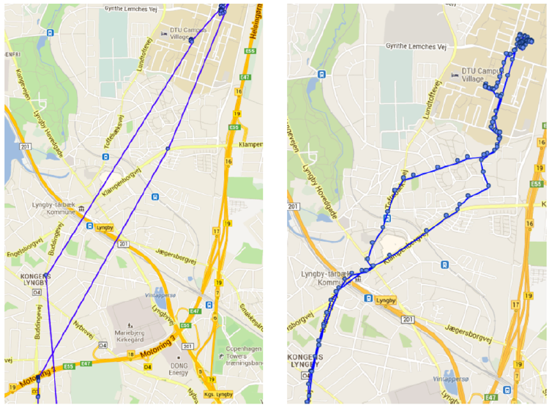
Example: Social Fabric
10 min GPS wifi

Slide 48
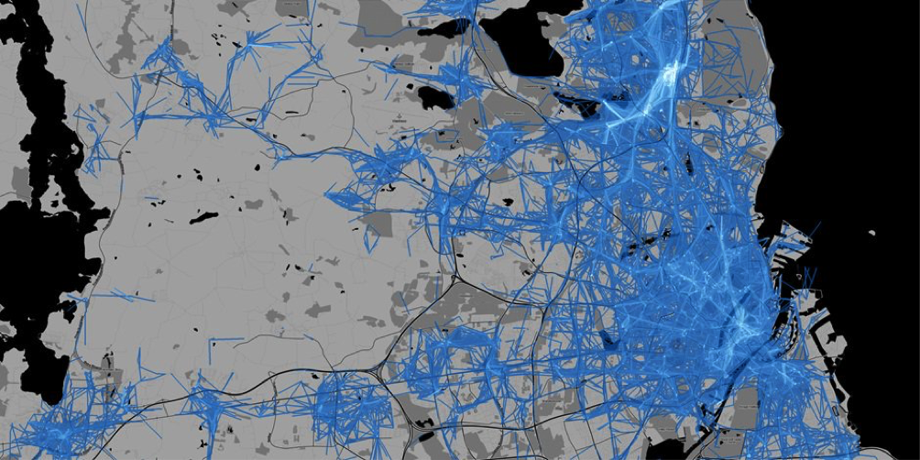
Example: Social Fabric

Slide 49
Example: peer effects in education economics
Students allocated to study and social groups, called vector groups (randomly)
Are there peer effects, i.e. are students’ grades/health behavior/study behavior affected by the group?
Literature: sometimes yes, sometimes no; very heterogeneous
Why? Perhaps being allocated to group is not = to actually meeting / using group

Slide 50
Example: peer effects
Think of allocation to group as intention to treat (similar to offering treatment)
Interesting example: Carrell et al, ECMA 2013. Small groups, yes peer effects; large groups: no/negative peer effects – WHY?
Use phone to measure frequency of group members being together physically, measured by bluetooth
Three parts: (i) yes they are more together; (ii) more together => work better together; (iii) peer effects?

Slide 51
Broader issue: Who meets, and how close are they?
Again: use bluetooth signals to measure meetings (duration, participants)
Analyzes 3.1 mio meetings over two months
Some results:
Women/women pairs -> closer
Facebook friends -> closer
Same study -> closer
Difference in beauty -> further apart
One overweight, one not -> further apart
People who stand very (too) close to others have fewer friends (!?)

Slide 52
Prediction vs causality
Measure class attendance from phone data (wifi/GPS/bluetooth)
Either: construct clusters at slots known as teaching time; or: use admin info on class locations and construct GPS overlays
Facebook activity
Predict grades

Slide 53
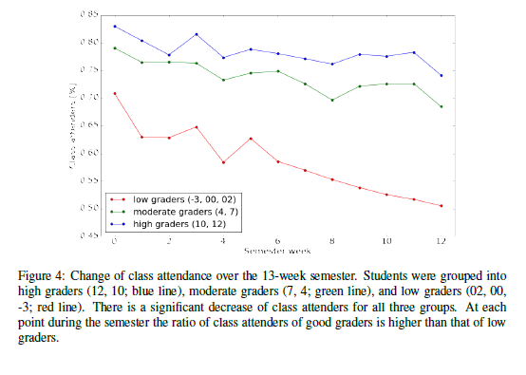

Slide 54
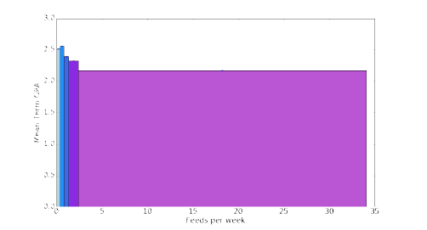

Slide 55
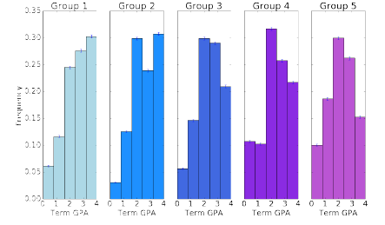

Slide 56
Prediction vs causality
Attendance -> grades/comprehension
People who attend more learn more
People who spend less time on Facebook have more time for studying
AND/OR
Grades/comprehension -> attendance
Find courses hard -> stay at home, more tempted by Facebook

Slide 57
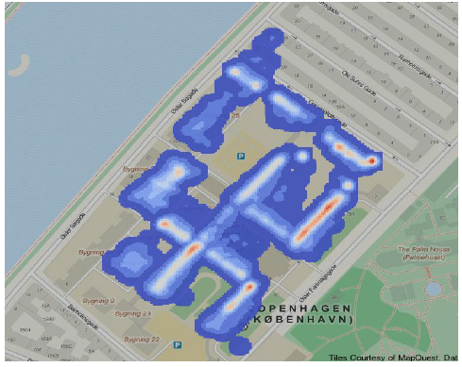
Example: CSS
Heat map of people with mobile devices on CSS (anonymous)

Slide 58
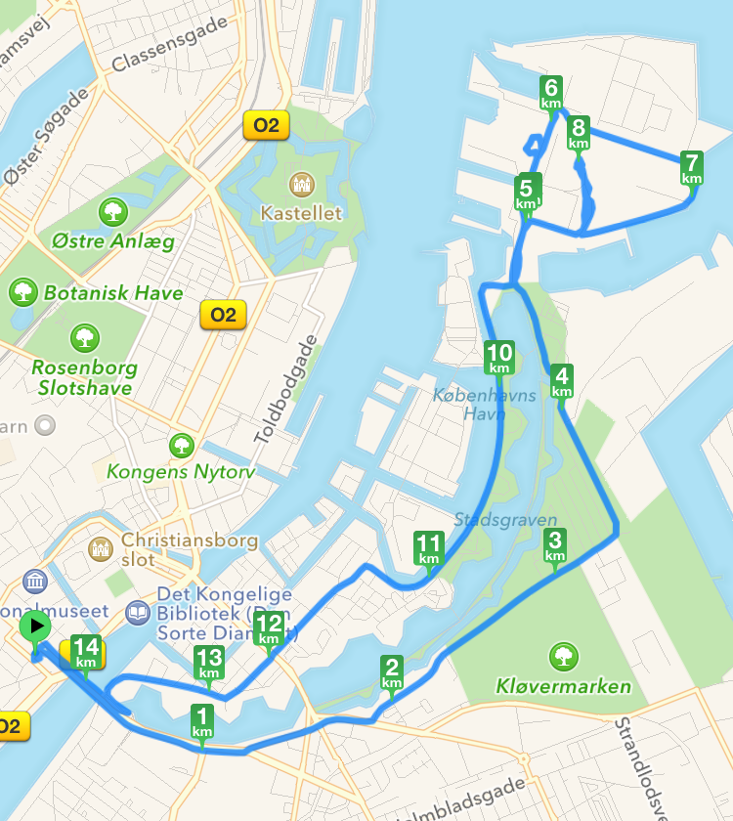
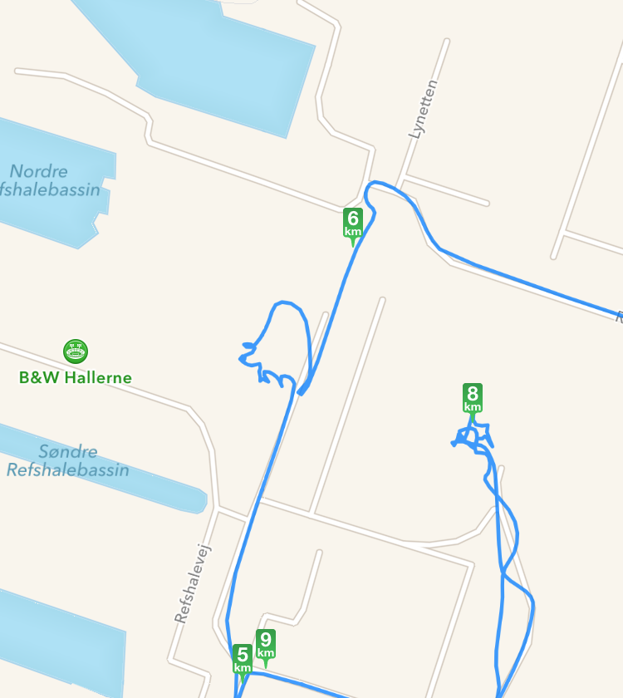
Example: David some Saturday

Slide 59
Example: David some Saturday
Flea market

Slide 60
Example: how to measure consumer spending
Economically important:
Indicator of health of economy
Important for understanding individual responses to policy
d.o. to economic shocks
Important for consumer prices -> inflation -> adjustments of wages and transfers
In developing countries: important for estimates of poverty, inequality

Slide 61
Example: consumer spending
Traditional methods:
Consumer expenditure surveys (DK: forbrugsundersøgelsen)
Diary or scanner
Errors, selection
Economists wanted access to individual spending data from Dankort for a long time
No luck
Recently, Statistics Denmark got access to COOP-card data to measure inflation
To be made public soon, pretty good fit with existing measures (and much faster)
Nice idea, incentive compatible
Indep of payment type
But selection?

Slide 62
Example: consumer spending
Attempts in developing economics
Use smart phones as scanner or means of payment
what can we infer about individuals from smart phone use (dedicated users)
Selection into who has smart phones
But should be seen against other ways of collecting data
Qs:
How can we use smart phones to infer spending better?
What kinds of economically interesting data can we collect via smartphones?

Slide 63
Statistical analysis of Big Data
Many observations: what does statistical significance mean?
And what is practical relevance? Size effects
Multiple testing problems? If big data generates many variables, why not run through them all to see what is significant?
Correct standard errors
In some cases, ‘eyeball econometrics’ can be difficult
Need systematic approach

Slide 64
Statistical/machine learning
Suppose you have no or very little theory to guide you
OLS is not only linear, but also presumes some idea of what actually goes in there and how
Varian’s Titanic example: who survived the Titanic
Two variables: Class and age
Researcher decide / guess vs. data analysis yield most likely (decision tree, but lots more complicated -> Snorre, later)
Einav, Levin: Econ should consider machine learning

Slide 65
Statistical analysis of Big Data
But what if you have theory (or think you have) – e.g.combine econometrics and machine learning
Goes back to old debate in economics
Milton Friedman (1953): judge a model by its predictions, not its assumptions
Machine learning made for prediction not for hypothesis testing and theory (in)validation

Slide 66
roadmap
Different data for different questions
Theory and empirics, forecasting and hypothesis testing
Effects of causes vs. Causes of effects
Data generating process
Modes of data collection – pros and cons
Strategic data management and data production

Slide 67
Strategic data management and production
People / firms / governments do not always provide truthful and/or complete data
Example: No penalty for lying in surveys – but no reason not to either
Political reasons for obscuring or inventing data: Greece in EU, Chinese economy
Firms: Proprietary info, competition reasons, fooling customers and regulators (VW)

Slide 68
Strategic data management and production
Individual demand for privacy (We return to this)
Could be instrumental:
lack of privacy decreases consumer surplus by better estimate of reservation price (e.g. Steering: Mac vs PC when ordering online)
Concerns about political issues
Or an objective in itself: Privacy as a political goal

Slide 69
Social desirability bias I
Key concern in surveys, but more general problem: What if people answer so as to conform with general notions of what’s desirable?
Examples: Won’t admit to not voting or having sexually transmitted diseases, exaggerates income
Reports buying healthy food vs unhealthy food
Important for asking/assessing sensitive questions

Slide 70
Social desirability bias II
Why?
Distinguish
self-deception
impression management
Example: What do you value most in a potential mate?
People say: "kind and understanding”
From dating data: physical attractiveness, status
Bias could be both (a) and (b)

